Slide 1
Analytic Evaluation assignment eBay
Assignment done by: Pedro Alves, 88861, MIECT
Martim Neves, 88904, MIECT
Diogo Fernandes, 89221, MIECT
Within the scope of the course: Human-Computer Interaction (HCI)
Class: P1
March 17th, 2020

Slide 2
Nowadays, Internet and online shopping have become part of our daily routine. Therefore, it made sense to us to choose the platform eBay to be our target of study in this assignment, since it is one of the most used online shopping websites in the world.
eBay allows every user, whether it’s a single person, a store or company, to buy and/or sell products on they’re website. So, it is directed to everyone who is looking to buy/sell and kind of product.
The User Interface on eBay is simple and intuitive. The main page shows the most recently viewed products, daily offers and items recommended for you, based on your search history. It also has a search bar at the top of the page to make finding na item easier. When search something on the search bar, eBay will show you a list of products that are a best match for what you searched for. Additionally, when you open any product, it also shows products similar to that one, that might interest you.

Slide 3
Evaluation method
The evaluation method used is composed of, in the first part, Heuristic Evaluation, according to the set of heuristics present in the course’s slides.
We chose to use a severity scale varying from 1 to 10, 1 being the minimum severity and 10 being the maximum severity, because we think it is a large enough scale to allow us to correctly measure the severy of a problem, while also allowing us to properly differentiate problems with different severities.
For the second part of the evaluation method we used Streamlined Cognitive Walkthrough, using the two given questions.

Slide 4
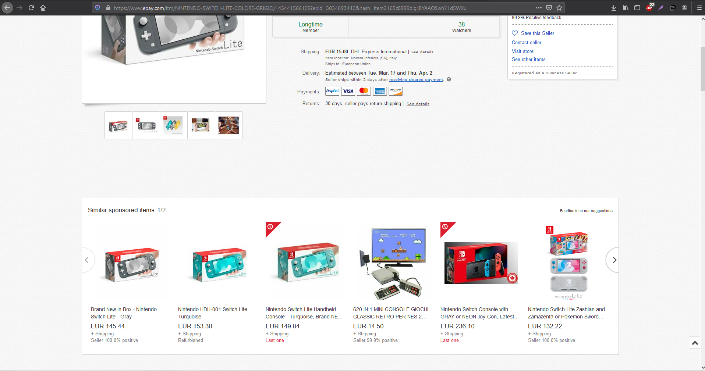
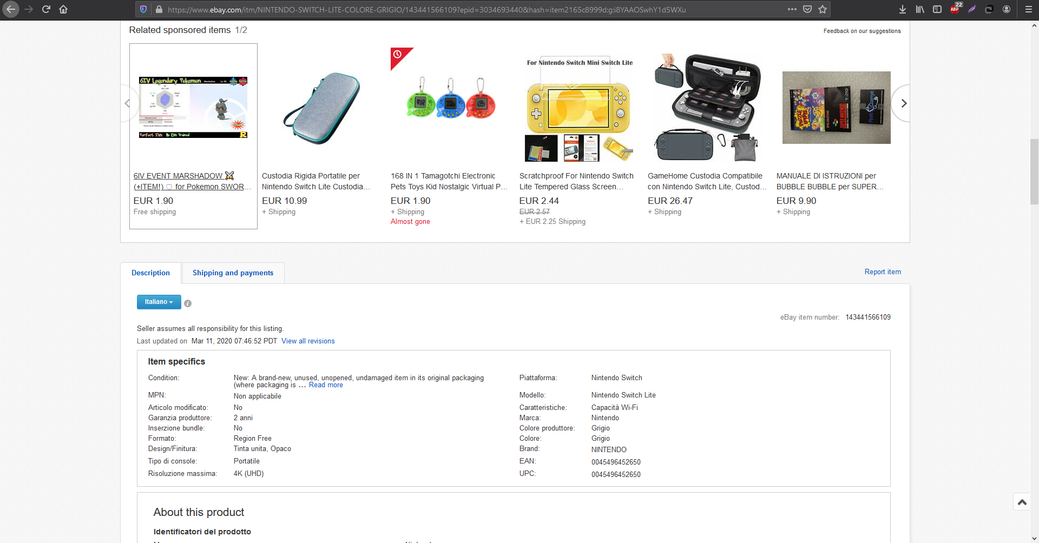
Issue: Recommended items show before the description of the product we want to see
Heuristic: Aesthetic and minimalist design
Severity: Pedro- , Martim-3, Diogo- , Median-

Slide 5
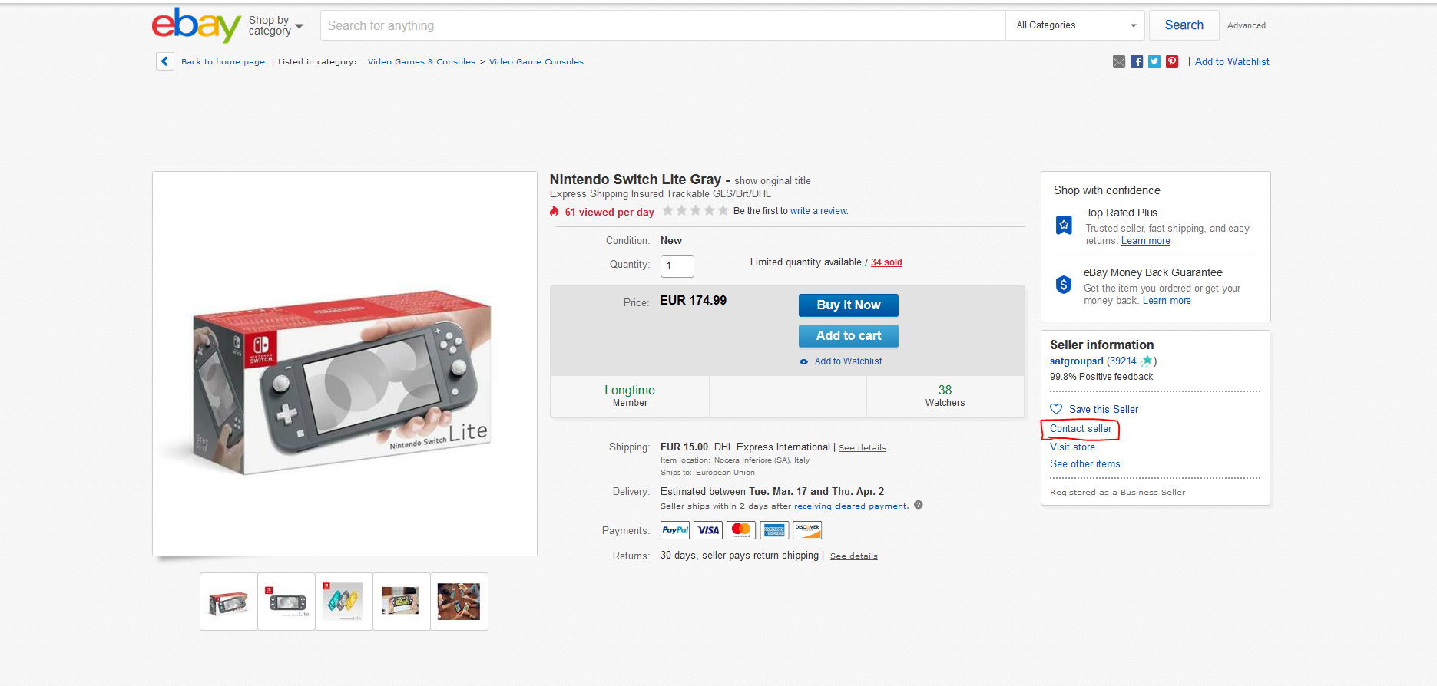
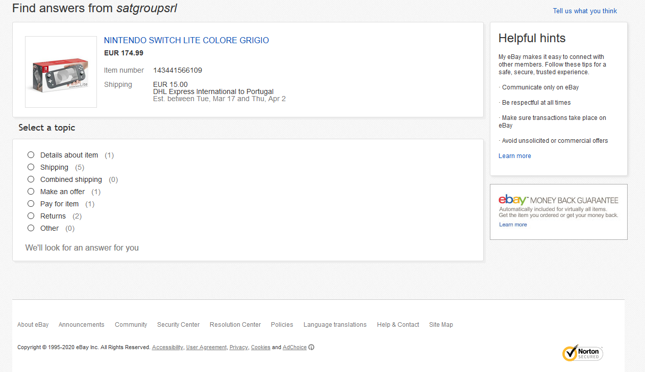
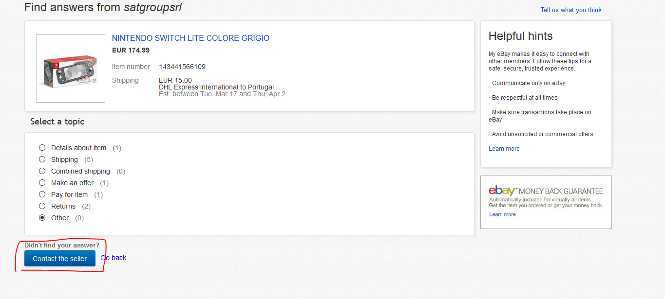
Issue: Hard to find and too many steps to ask the seller something about the product.
Heuristic: Aesthetic and minimalist design
Severity: Pedro- , Martim-4, Diogo- , Median-

Slide 6
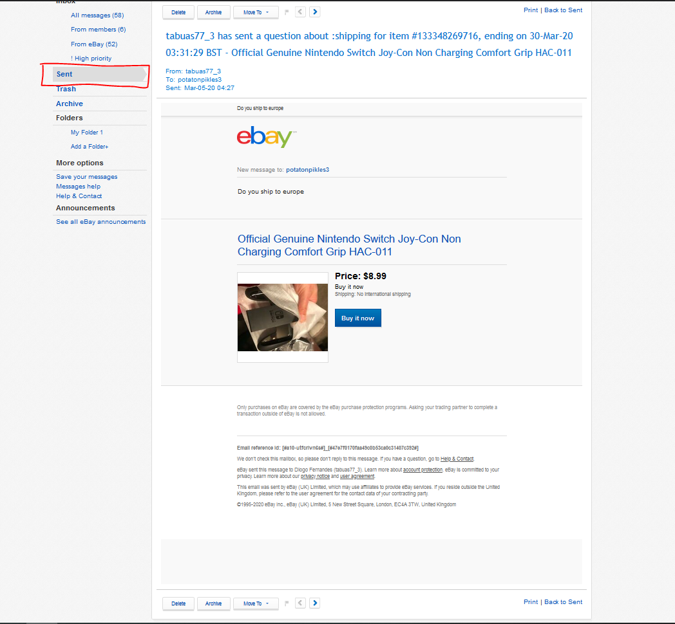
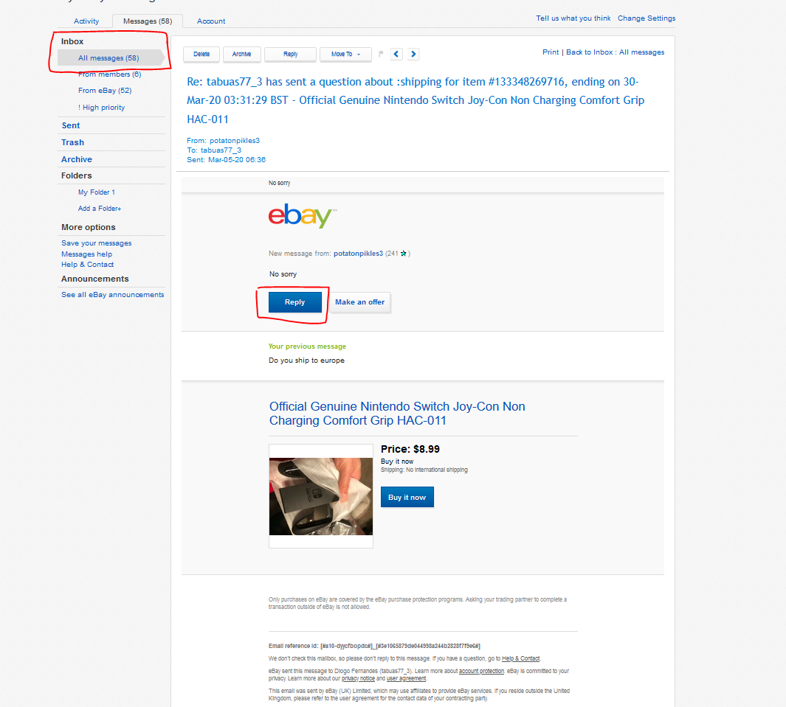
Issue: Can’t reply to messages in the “sent” messages. Makes it harder to send messages to the seller if he doesn’t reply.
Heuristic: Flexibility and efficiency of use
Severity: Pedro- , Martim-6, Diogo- , Median-

Slide 7
O mesmo que o slide anterior mas para o cognitive walkthrough

Slide 8
Task- Contact the seller if he doesn’t reply to messages
User- Any person who doesn’t use eBay very often
Issue: It’s not possible to open the conversation with the seller and send another message
Q1- Will the user know what to do at this step?
Possibly not! The first thing most people would
do is open their messages and try to send
another message. However, eBay doesn´t let
you do that and there is nothing telling the user
how to send another message

Slide 9
Q2-If the user does the right thing, will they know that they did the right thing, and are making progress towards their goal?
The only way to send another message is to go to “All Messages”, find the last message the user sent to the seller, and only then it is possible to send another message. However, eBay doesn’t let the user know, in any way, if that is the right procedure to reach their goal.

Slide 10
Remaining problems and it´s Heuristic Evaluation
 | Pedro | Martim | Diogo | Median
Help button is too small and hidden at the end of the page |  | 6
Problema 2
Problema 3

Slide 11
Slide final tipo conclusão para dizer o que achamos do ebay

